Slide 1
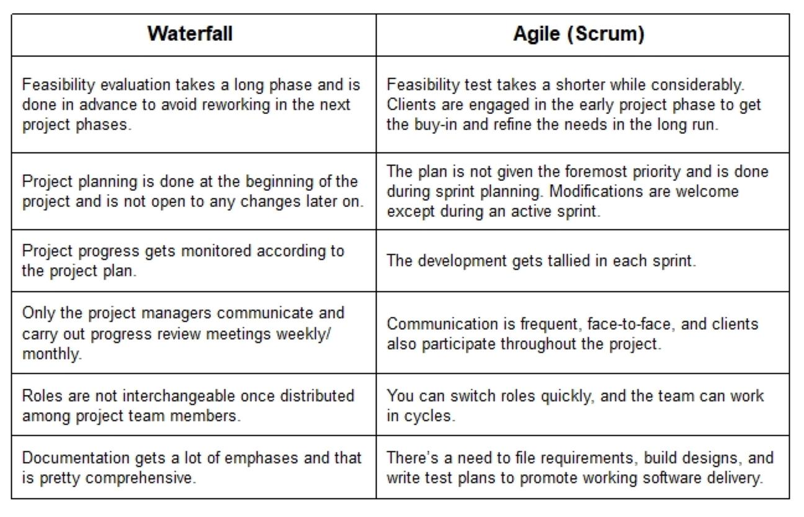

Slide 2



Agile Methodology
National Aeronautics and Space Administration
Introduction to Agile Methodology
SOFTWARE PROCESS IMPROVEMENT
NASA Goddard Space Flight Center
www.nasa.gov
SOFTWARE PROCESS IMPROVEMENT NASA GSFC

Slide 3
Agile Methodology
Introductions
– Alex Durkin, Software Process Improvement Team
http://software.gsfc.nasa.gov
SOFTWARE PROCESS IMPROVEMENT
NASA GSFC
<number>

Slide 4
Goals
Common understanding of Agile fundamentals
Origins of Agile
Key Concepts / Activities / Roles
Common Misconceptions
Strengths and Weaknesses
SOFTWARE PROCESS IMPROVEMENT
NASA GSFC
<number>

Slide 5
What is Agile?
Definition*: The Agile Alliance defines Agile Software Development in this way:
In the late 1990’s several methodologies began to get increasing public attention. Each had a different combination of old ideas, new ideas, and transmuted old ideas. But they all emphasized:
Close collaboration between the programmer team and business experts
Face-to-face communication (as more efficient than written documentation)
Frequent delivery of new deployable business value
Tight; self-organizing teams working cooperatively
Ways to craft the code and the team such that the inevitable requirements churn was not a crisis
The Agile Manifesto was written in February of 2001, at a summit of 17 independent-minded practitioners of several programming methodologies.
*Definition of Agile from Agile Alliance, a non-profit organization founded by some authors of the original Agile Manifesto to advance Agile concepts; http://www.agilealliance.org/the-alliance
SOFTWARE PROCESS IMPROVEMENT
NASA GSFC
<number>

Slide 6
What is Agile?
Interestingly, Agile concepts are applied to fields outside of software
Toyota implemented Agile techniques long before software development
One of which was a task board in 1953, in Agile software development this became known as a Kanban board
– Team Wikispeed is using an Agile method called Scrum to build a fast, affordable, ultra-efficient, safe commuter car that should sell for less than $20,000
There are many methods implementing the Agile Software Development
Methodology. Most notable:
Lean
Kanban
Extreme Programming (XP)
Scrum -- most popular
SOFTWARE PROCESS IMPROVEMENT
NASA GSFC
<number>

Slide 7
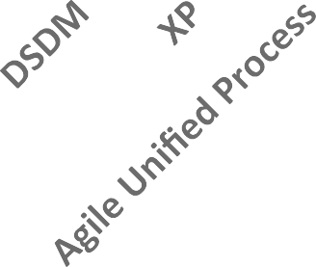

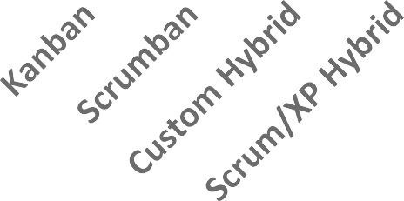
Agile Methods In Use
60
50
40
30
20
10
0
SOFTWARE PROCESS IMPROVEMENT
NASA GSFC
<number>
% Adopted
Version One 9th Annual State of Agile™ Survey

Slide 8
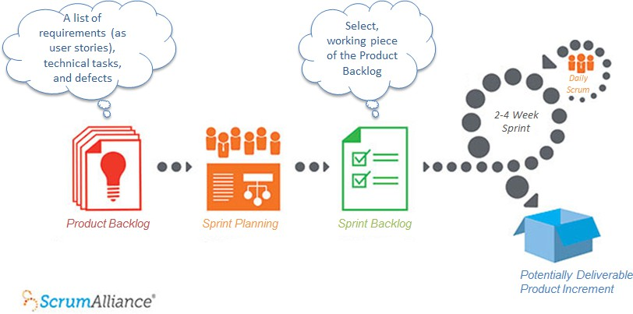

Scrum Framework
NASA GSFC
<number>
Original diagram from the Scrum Alliance
SOFTWARE PROCESS IMPROVEMENT

Slide 9
Scrum – Key Concepts
Product Backlog
The product backlog is a list of requirements (as user stories) and technical tasks which the team maintains and that, at a given moment, are known to be necessary and sufficient to complete a product or a release
The product backlog is the primary point of entry for knowledge about requirements, and the single authoritative source defining the work to be done
Includes features, defects, and other technical work
Any format: Excel document, a text file, a database
Agile teams commonly use a collection of index cards or Post-It notes on a task board (Kanban)
Sprint Backlog
The sprint backlog is a working subset of the product backlog, small enough to be completed in a single sprint
SOFTWARE PROCESS IMPROVEMENT
NASA GSFC
All Term definitions from the Agile Alliance, the Scrum Alliance, the Mountain Goat Software website by Mike Cohn, a founder of the Agile Alliance; and the Agile Modeling website by Scott Ambler, author of “Disciplined Agile Delivery”.
8

Slide 10
Scrum – Key Concepts
User Story
A user story is a method to capture desired product features from the perspective of a user or customer.
Defined and sorted by priority into the Product Backlog by Product Owner
Concise enough to fit on an index card
Each user story is expected to yield, once implemented, a contribution to the value of the overall product, irrespective of the order of implementation
Generally high level at first, they can evolve and be refined into low-level user stories, or requirements
It’s often best to think of the written part as a pointer to a real requirement
Detail can be added by adding “conditions of satisfaction”
Stories can be assigned points based on size and complexity
Commonly takes the form of:
As a <type of user>, I want <some goal> so that <some reason>.
Example:
“As a power user, I want to specify files or folders for backup based on file size, date created and date modified, so I can prioritize items for backup.”
May belong to the higher-level user story (epic): “As a user, I can backup my entire hard drive.”
SOFTWARE PROCESS IMPROVEMENT
NASA GSFC
<number>

Slide 11
Scrum – Key Concepts
Sprint
The sprint is a set amount of time (either 2 or 4 weeks) determined to be sufficient to develop a working deliverable software based on the product backlog
It is a time-boxed effort, completing all 4 phases (analysis, design, implementation, testing)
Automated testing is widely used in Agile
The end product of the sprint is working software that is complete and potentially deliverable
Daily Scrum, or Daily Stand-up – during the Sprint, less then 15 minutes
Purpose: Inspect progress, identify impediments to progress
Participants: Scrum Master and Team – Product Owner and other stakeholders are invited in listen- only mode
The daily stand-up is 10-15 minute daily briefing while standing
Each team member addresses:
What did I do yesterday that helped the Development Team meet the Sprint Goal?
What will I do today?
Are there any roadblocks in my way?
SOFTWARE PROCESS IMPROVEMENT
NASA GSFC
<number>

Slide 12
Scrum – Key Concepts
Sprint Planning – at most 8 total hours for a one month Sprint
Purpose: Determine work for next Sprint
Participants: Owner, Scrum Master, Team
The sprint planning meeting is when the product owner describes the highest priority features to the team, and the team moves user stories from the product backlog into the sprint backlog
Artifacts resulting are a Sprint goal and the Sprint backlog
Sprint Review – after the Sprint, at most 4 hours
Purpose: Inspect completed work, adapt priorities for next Sprint
Participants: Owner, Scrum Master, Team, Stakeholders, other developers
The sprint review is a review meeting held at the conclusion of a sprint where the team presents this software, as a demo or a test drive, to the external stakeholders and discuss how to adapt the product to the overall feedback.
Artifacts resulting may be new user stories for the product backlog
Typically held to no more than 2 hours, and attended by Product Owner, Scrum Team, Scrum Master, and external stakeholders
SOFTWARE PROCESS IMPROVEMENT
NASA GSFC
<number>

Slide 13
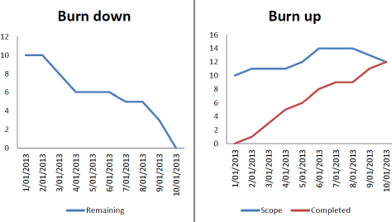
Scrum – Key Concepts
Burn-down chart
A product burn-down chart shows the number of backlog items completed vs yet to be completed overall
(updated after each sprint)
A sprint burn-down chart shows the number of remaining sprint backlog items completed vs yet to be completed in the current sprint
(updated daily)
SOFTWARE PROCESS IMPROVEMENT
NASA GSFC
<number>
http://www.clariostechnology.com/productivity/blog/burnupvsburndownchart
Burn-up chart
More visible when the scope of the product changes, but harder to convey when the end of the process will be

Slide 14
Scrum – Key Concepts
Retrospective – after the Sprint Review, before the next Sprint Planning, at most 3 hours
Purpose: Identify improvements to Team development process
Participants: Scrum Master and Team
The retrospective is a dedicated period at the end of each sprint to deliberately reflect on how the team is doing and to find ways to improve.
Typical artifacts are lessons learned to be reviewed next retrospective
Scrum master asks:
“What went well during the sprint?
“What could be improved in the next sprint?”
Velocity
The velocity is a measure of how much work was completed during the sprint
Usually measured in stories completed or story points instead of hours
Allows for scoping of future sprints
SOFTWARE PROCESS IMPROVEMENT
NASA GSFC
<number>

Slide 15
Scrum – Key Concepts
Technical debt
The technical debt is unfinished work after a sprint is over
Can build up over several sprints
Gets prioritized and placed on the Product Backlog
Sprint Zero
Sprint Zero, or the sprint before sprints, is a phrase coined for an initial sprint limited to project setup and initiation
Used for planning the sprint backlog, performing installs, and other prep activities
No released software
Still a 2-4 week period, like any other sprint
SOFTWARE PROCESS IMPROVEMENT
NASA GSFC
<number>

Slide 16
Scrum – Additional Concepts
Product Backlog Refinement – less then 10% of total team effort
Backlog refinement, or grooming, is the process of soliciting, refining and ranking requirements by the Product Owner with input from the Team and Customers
Users stories can be added, removed or split
Priorities and estimates are developed or changed
All stakeholders should understand the ranking criteria and resulting priorities
Hardening Sprint
A hardening sprint is an additional sprint that some Scrum Teams perform to ready the product for release
Controversial concept that isn’t universally accepted
Scrum teams often use it to tie up the loose ends identified during this sprint or earlier sprints
All Term definitions from the Agile Alliance, the Scrum Alliance, the Mountain Goat Software website by Mike Cohn, a founder of the Agile Alliance; and the Agile Modeling website by Scott Ambler, author of “Disciplined Agile Delivery”.
SOFTWARE PROCESS IMPROVEMENT
NASA GSFC
<number>

Slide 17
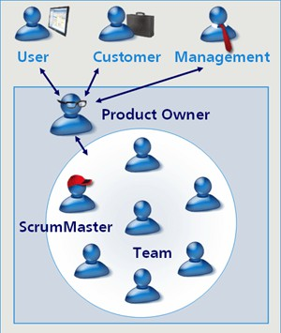
Scrum Roles
External Stakeholders:
User – The end user of the product
Customer – Client often paying for the work
Management – Use a hands-off approach with the technical team, coordinate with product owner, attend milestone reviews as “listen-only”
Internal Stakeholders:
Product Owner – Represent the interests of the external stakeholders, act as a filter between team and external stakeholders, maintain the product backlog
Scrum Master – Leading member of the team that focuses on the success of the sprint, runs the daily stand-up
Scrum Team – A cross-functional team made up of the developers, testers, architects, administrators and software assurance
SOFTWARE PROCESS IMPROVEMENT
NASA GSFC
<number>
https://noogony.wordpress.com/ 2010/09/19/5-tips-voor-een-succesvolle- sharepoint-implementatie-adhv-scrum- deel-1/
Co-located, frequent communication - at the least meets daily
Recommended size of 3-9 people
Self-organizing but within a set boundary
The focus is to get work done, even if you need help
Scrum Role definitions derived from the Scrum Methodology and the Scrum Alliance

Slide 18
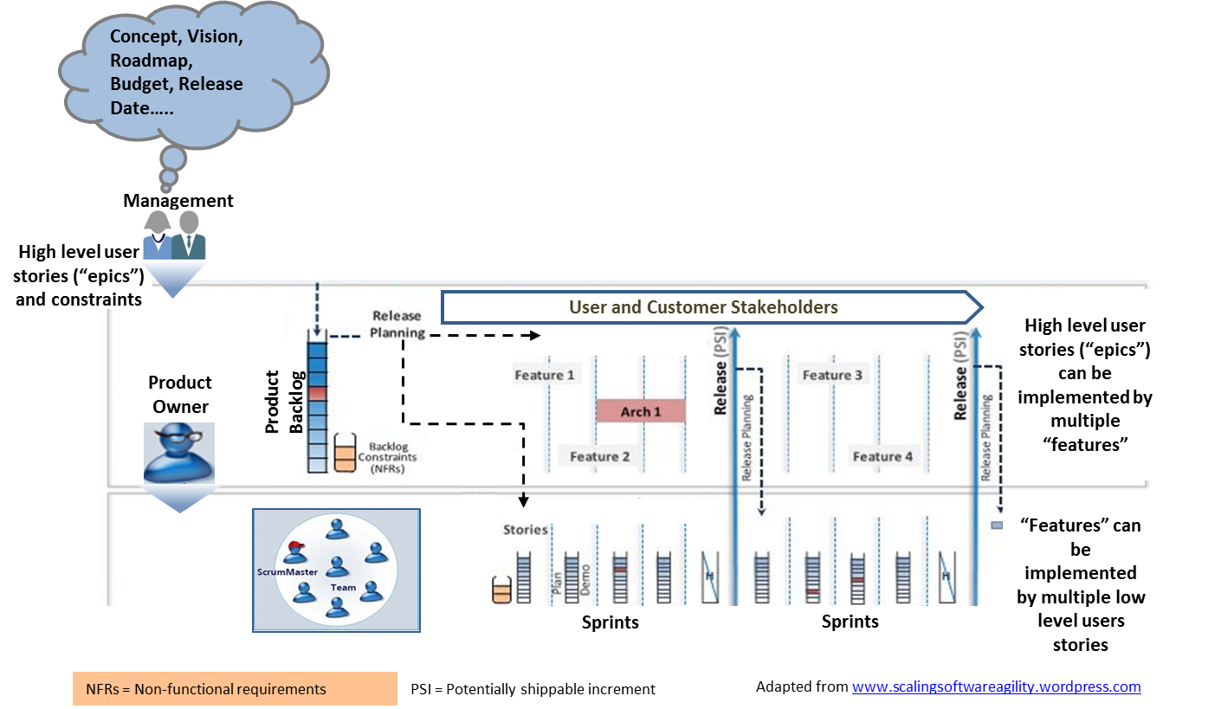
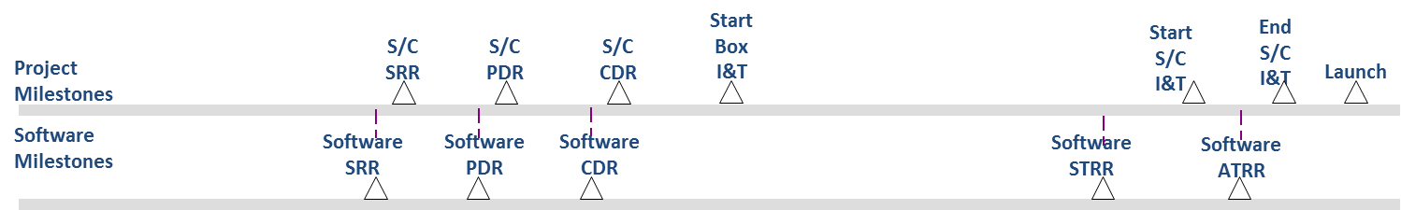
SOFTWARE PROCESS IMPROVEMENT
NASA GSFC
<number>

Slide 19
Common Misconceptions
Agile is synonymous with Scrum
Agile means no documentation
Agile means no planning – just coding
Agile only works when everyone is co-located
Agile means faster and cheaper
SOFTWARE PROCESS IMPROVEMENT
NASA GSFC
<number>
The Agile Manifesto: http://www.agilealliance.org/the-alliance/the-agile-manifesto/

Slide 20
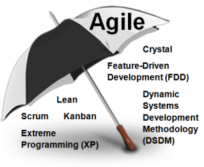
Common Misconceptions
“Agile is synonymous with Scrum”
Scrum is one development method that implements Agile (the most popular one)
Scrum is constantly evolving through an active community, leading to many hybrid adaptations
Scrum implements all the values and principles of Agile
NASA GSFC
<number>
• Scrum and Agile, synonyms? (and other Agile methodologies)
SOFTWARE PROCESS IMPROVEMENT

Slide 21
Common Misconceptions
“Agile means no documentation”
A focus in Agile is working software over documentation (but not instead of
documentation)
Agile calls for more frequent updates to documentation
Documentation is done real time focusing on the sprint, rather than documenting everything all at once
The Agile version of documentation says:
There is an overall plan
There are requirements descriptions
There are cost and schedule estimates
There are risk assessments
There is training material (as appropriate)
There is documentation (as appropriate)
There are lessons learned (based on retrospectives)
What Does the Agile Manifesto Mean? and
Agile software development, the principles. Principle 9 : Continuous attention to technical excellence and good design enhances agility
SOFTWARE PROCESS IMPROVEMENT
NASA GSFC
20

Slide 22
Common Misconceptions
“Agile means no planning – just coding”
Agile seeks to eliminate “analysis paralysis” through shorter planning cycles, hopefully 2-4 weeks
Teams are self-organizing, so Agile is not focused on task assignments
In Scrum, sprint planning can evolve each sprint
Sprint planning before each sprint
Sprint Zero is 2-4 weeks of planning before coding starts
Developers can’t start coding in a sprint until the Scrum master has picked out the User Stories for the Sprint Backlog
After the end of every sprint, a few hours are spent planning
While the development lifecycle is dynamic, product plans and system testing are still necessary
SOFTWARE PROCESS IMPROVEMENT
NASA GSFC
<number>
What Does the Agile Manifesto Mean? and
Agile software development, the principles. Principle 11: The best architectures, requirements, and designs emerge from self-organizing teams

Slide 23
Common Misconceptions
“Agile only works when everyone is co-located”
Agile is heavily focused on face-to-face communication
This does not mean teams have to be co-located - video conferencing is one solution
Be aware that a more geographically distributed team could then increase cost
The Agile methodology stresses that email and phone conversations are no substitute for the daily meetings
A mitigation for a user not co-located is to employ a local user representative
There are Agile scaling techniques to accommodate multiple teams in separate locations
Two different scrums in two different locations operate as normal, and the Scrum Masters from each meet to define Sprint Backlog
SOFTWARE PROCESS IMPROVEMENT
NASA GSFC
<number>
What Does the Agile Manifesto Mean? and
Agile software development, the principles. Principle 6: The most efficient and effective method of conveying information to and within a development team is face-to-face conversation.

Slide 24
Common Misconceptions
“Agile means faster and cheaper”
Agile defines short development and delivery cycles
This means that a working product is delivered faster
From the customer’s point of view, they receive success faster
Leads to a ‘fail fast’ scenario, where they realize that a product solution may be flawed, correcting their course early and potentially saving money
However Agile has a steep learning curve
Inexperience with Agile can lead to delays, building up technical debt or difficulty planning sprints
Sometimes leads to performing traditional methods when you thought you were being Agile
It’s common not to see added benefit to Agile until late in the lifecycle
Other Agile implementation can have different cost impacts
Pair programming and other XP techniques often cost more
SOFTWARE PROCESS IMPROVEMENT
NASA GSFC
<number>
Agile Alliance, the Scrum Alliance, the Mountain Goat Software website by Mike Cohn, a founder of the Agile Alliance; and the Agile Modeling website by Scott Ambler, author of “Disciplined Agile Delivery”.

Slide 25
Agile: Strengths and Weaknesses
Strengths
Users are kept involved in the process daily, increasing likelihood of validation
Weaknesses
Dependent on availability of users/customers or their representatives
Accepts changes in requirements during all stages of development
Increases in difficulty for larger development teams
High amount of risk analysis done
Requires strict adherence to activities
Avoid “analysis paralysis” by diving into development early
Some methods are more expensive (Pair- programming)
Working products are available throughout the process
Customer involvement can increase rework or gold-plating
SOFTWARE PROCESS IMPROVEMENT
NASA GSFC
<number>
Thrives with co-located teams
Added complexity for dispersed teams
Documentation is done real-time, during each iteration
Documentation not done real-time can lack important details
Strengths and weaknesses assisted by the Scrum Alliance and Version One – Agile made easy / as well as Before you make the leap to Agile – Ten weaknesses of Agile

Slide 26
Is Agile right for me?
A successful Agile methodology depends on embracing several key concepts (by both the development team and by management):
Having continuous user involvement
Having frequently deliverable software
Accept changes in requirements, even late in development
Daily communication and focus on efficiency through daily face-to-face stand-ups
Using retrospectives to reflect and improve every iteration
Trust that all team members and stakeholders will support the approach
Even if you’re not fully doing Agile, many of these concepts can still be used to construct strong project practices, like user involvement and demonstrations.
And most importantly, tailor to the task. Agile only asks you to inspect and adapt, how you do that is up to you.
SOFTWARE PROCESS IMPROVEMENT
NASA GSFC
<number>
See Water-Scrum-Fall article from the Scrum Alliance

Slide 27
Questions
Discussion
Closeout
SOFTWARE PROCESS IMPROVEMENT
NASA GSFC
<number>
Contact Alex Durkin with questions
Final slides on Software website, Training section, http://software.gsfc.nasa.gov

Slide 28
References
Agile Alliance – http://www.agilealliance.org
Scrum Alliance – https://www.scrumalliance.org/
Mountain Goat software - https://www.mountaingoatsoftware.com/
Ken Schwaber’s Blog - https://kenschwaber.wordpress.com/
Some Agile Methods - http://www.devx.com/architect/Article/32761/0/page/3
Top 10 Agile myths - http://www.agileconnection.com/
Version one - http://www.versionone.com/pdf/state-of-agile-development-survey-ninth.pdf
Kanban - https://www.atlassian.com/agile/kanban
About Agile - http://www.agilealliance.org/the-alliance/
About Scrum - http://scrummethodology.com
Scrum Roles - https://www.scrumalliance.org/why-scrum/core-scrum-values-roles
State of Scrum - https://www.scrumalliance.org/
Weaknesses: http://www.cedarpointconsulting.com/delivery/articles/before-making-the-leap-to-agile
Principles and definitions - https://technology.amis.nlhttps://technology.amis.nl/2008/07/01/
Bob Winter (2015). Agile Performance Improvement Synergy Technology, retrieved from http://www.amazon.com/Agile-Performance-Improvement-Synergy-Technology/dp/1484208935
SOFTWARE PROCESS IMPROVEMENT
NASA GSFC
<number>

